Slide 1
Rob Byrd Chief Enterprise Architect City of Austin, Texas
Aligning IT Services with Business Needs
Session Number: 1243

Slide 2
EA Purpose and Value
Identify important business needs using a data-driven, decision-making framework
Align information technology services to produce maximum business value
Deliver “horizontally” integrated enterprise solutions while recognizing innovative strategies
Identify risk early to mitigate decisions and solutions
We’ve evolved to a culture where there’s plenty of time and money to do it over, but never enough time and money to do it right…

Slide 3


EA = Business Requirements
No Blueprint = Disjointed Understanding
Blueprint = Mutual Understanding
critical understanding
momentum = mass x velocity
in a given direction

Slide 4
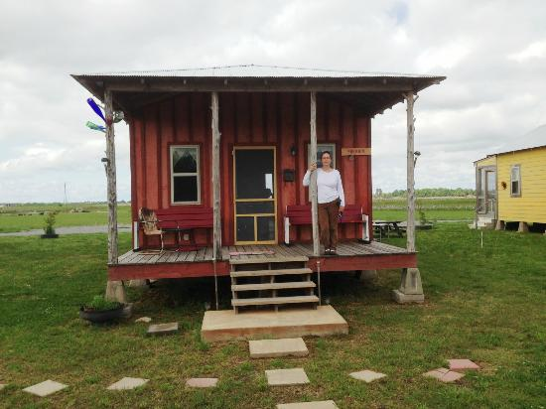
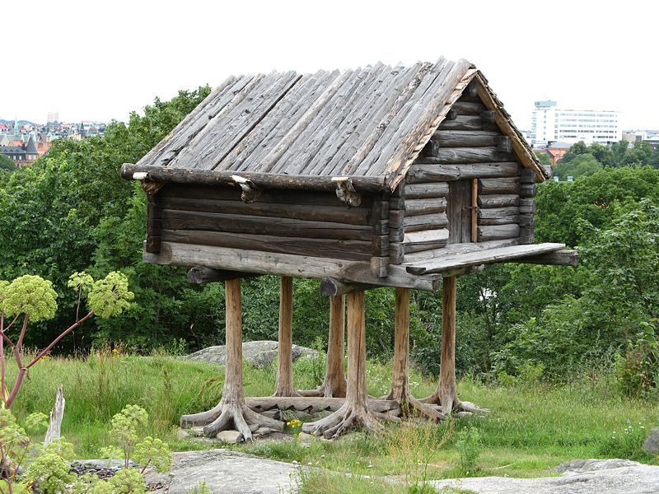
Importance of Design
What the business user wanted…
What the business user got…

Slide 5
Capability Understanding Drives Successful Solutions
Capability: People, processes and technology delivering value for a specific purpose. The quality of being capable; to have the capacity or ability to do something, achieve specific outcomes, effects or declared goals and objectives
Understand enterprise-wide capabilities…

Slide 6

Managing Complexity
<<vision>>
Best Managed City
<<capability>>
Manage Infrastructure
<<capability>>
Clean Water
<<capability>>
Equal Opportunities
<<capability>>
Healthy Economy
<<capability>>
Safe Public
<<capability>>
Healthy Community
<<capability>>
Reliable Energy
<<capability>>
Mobile Community
Establish Goals
<<goal>>
Conserve Water Resources
<<goal>>
Integrate Case and Asset Management
<<goal>>
Sustain Environment
<<goal>>
Optimize Operations
<<goal>>
Increase Revenue
<<goal>>
Respond to Customer Needs
<<goal>>
Define Mobile User Processes

Slide 7
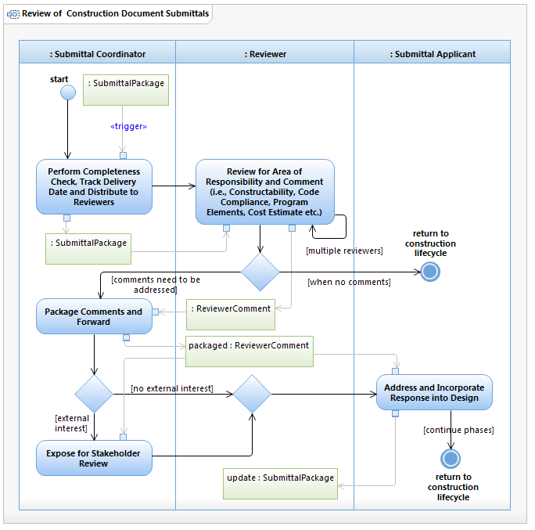
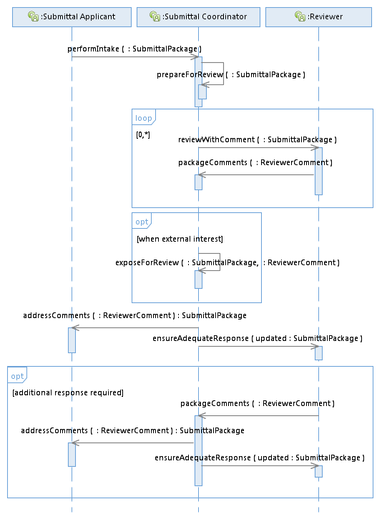

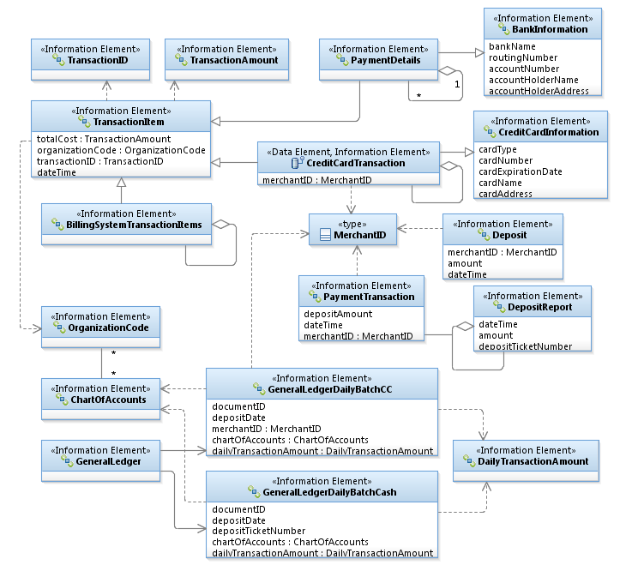
Managing Complexity
Process
Integration
Information
Business developed!

Slide 8
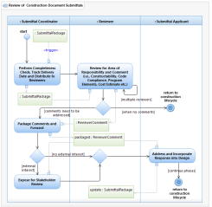
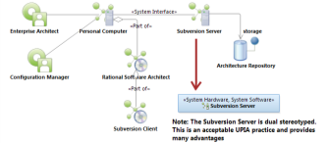
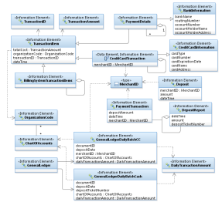
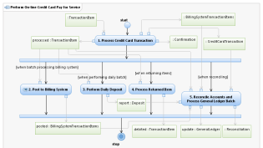
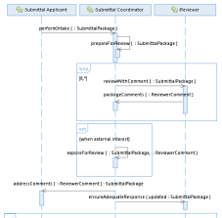
Identifying Common Opportunities
<<vision>>
Best Managed City
<<capability>>
Manage Infrastructure
<<capability>>
Clean Water
<<capability>>
Equal Opportunities
<<capability>>
Healthy Economy
Identify Common Capabilities
<<capability>>
Safe Public
<<capability>>
Healthy Community
<<capability>>
Reliable Energy
<<capability>>
Mobile Community
Identify Common Process
Goals Amplify Vision!
Identify Common Infrastructure
Top Down – Bottom Up
Identify Common Data
<<goal>>
Conserve Water Resources
<<goal>>
Integrate Case and Asset Management
<<goal>>
Sustain Environment
<<goal>>
Optimize Operations
Identify Common Goals
<<goal>>
Increase Revenue
<<goal>>
Respond to Customer Needs
<<goal>>
Define Mobile User Processes

Slide 9
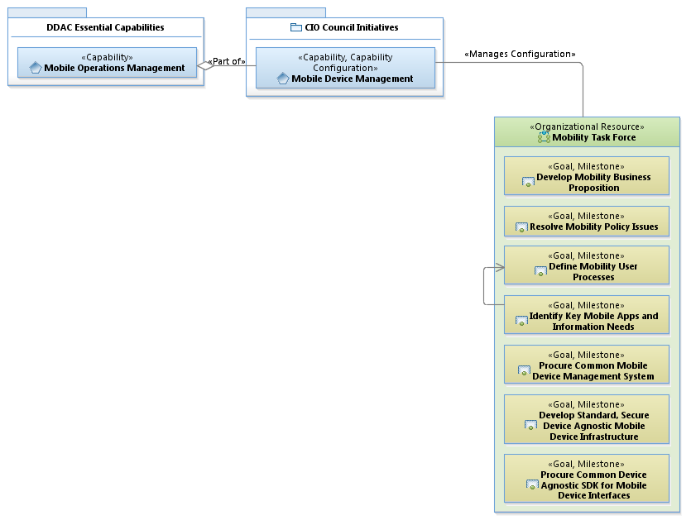
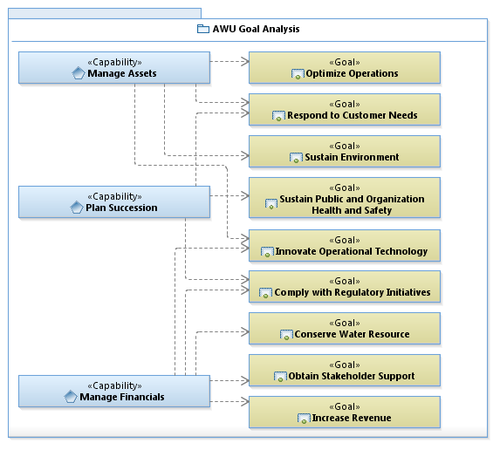
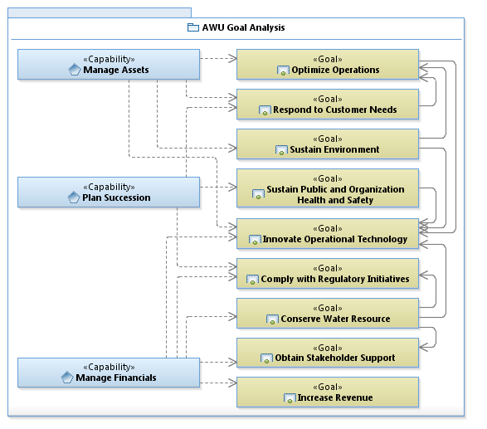
Connecting Business Needs to IT Solutions

Slide 10
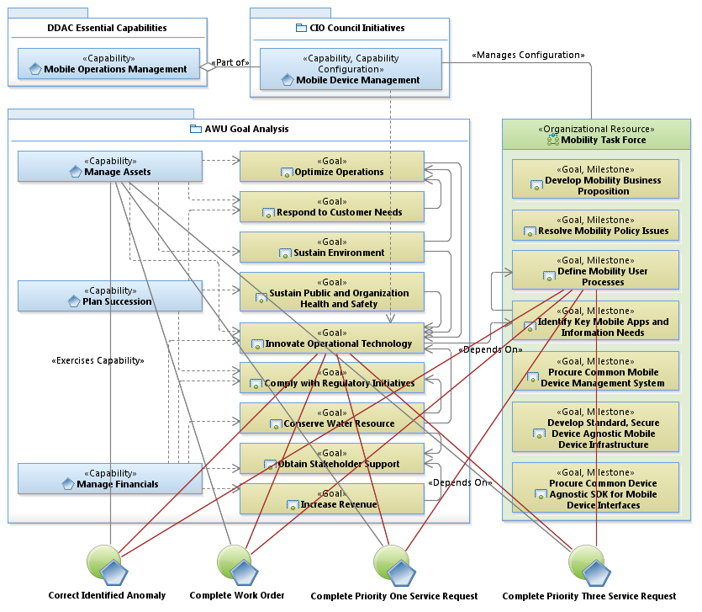
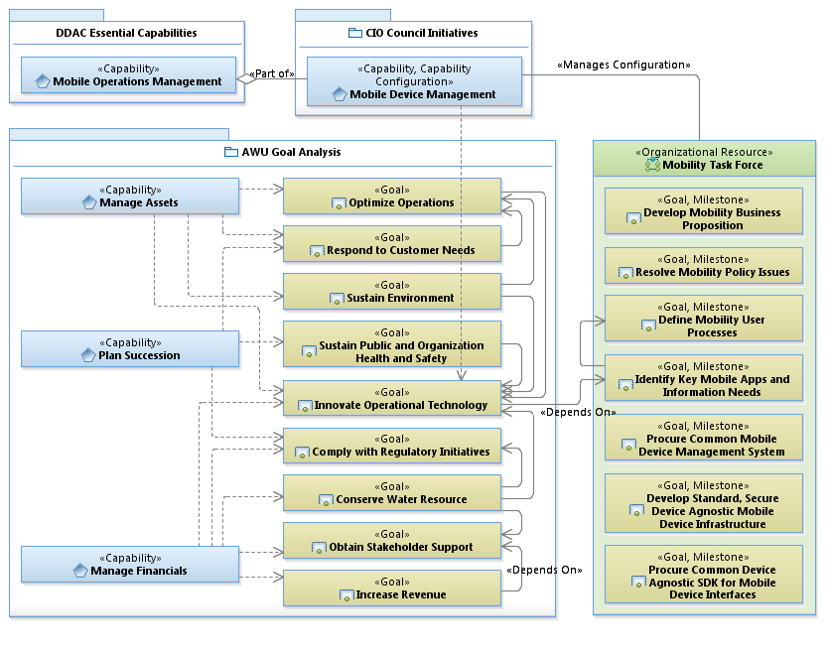

Slide 11
AWU Architecture Principles
Use architecture to identify important interfaces to define mobile application and information needs
Collaborate and vet architecture with stakeholders
Define mobile application specifications for inclusion in statement of work

Slide 12
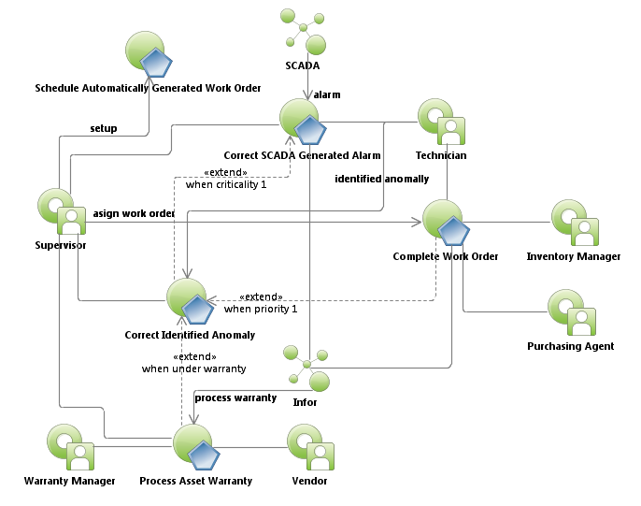
Water Treatment Plant Work Order Use Case Relationships
Requires Mobility

Slide 13
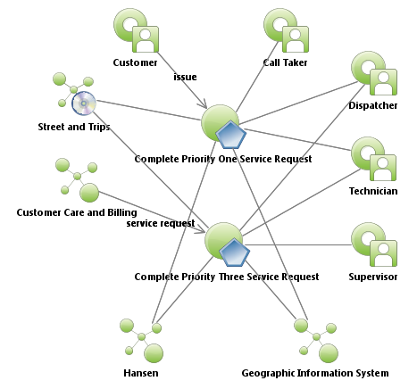
Water Distribution Field Service Request Use Case Relationships
Requires Mobility

Slide 14
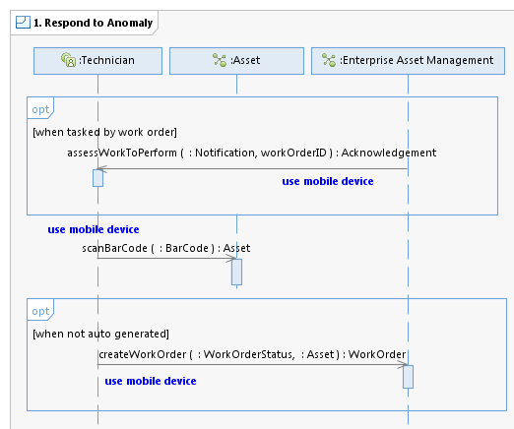
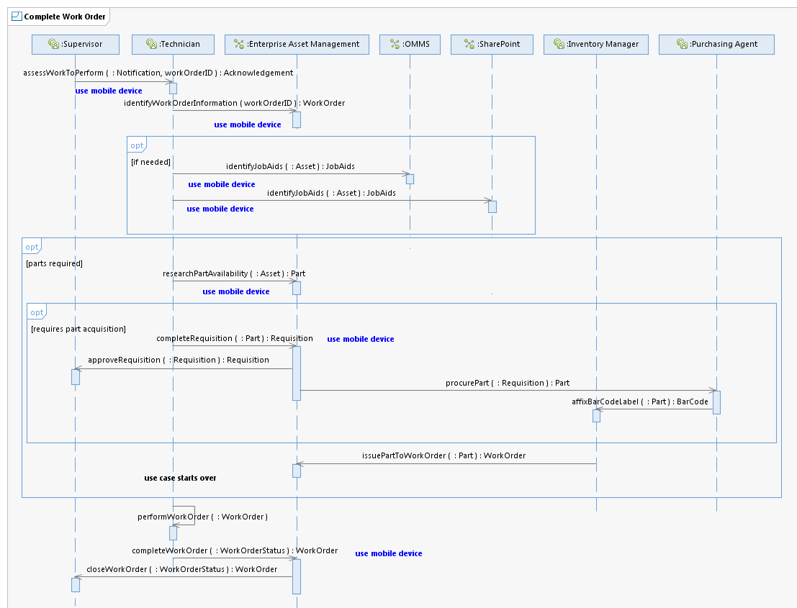
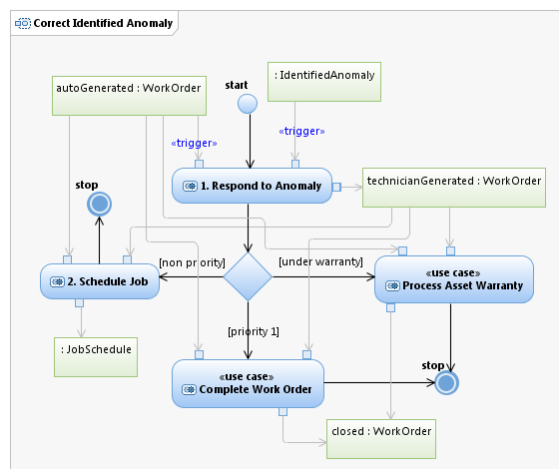
Correct Identified Anomaly
Designed in collaboration with field
Technicians. Stakeholder approved!

Slide 15
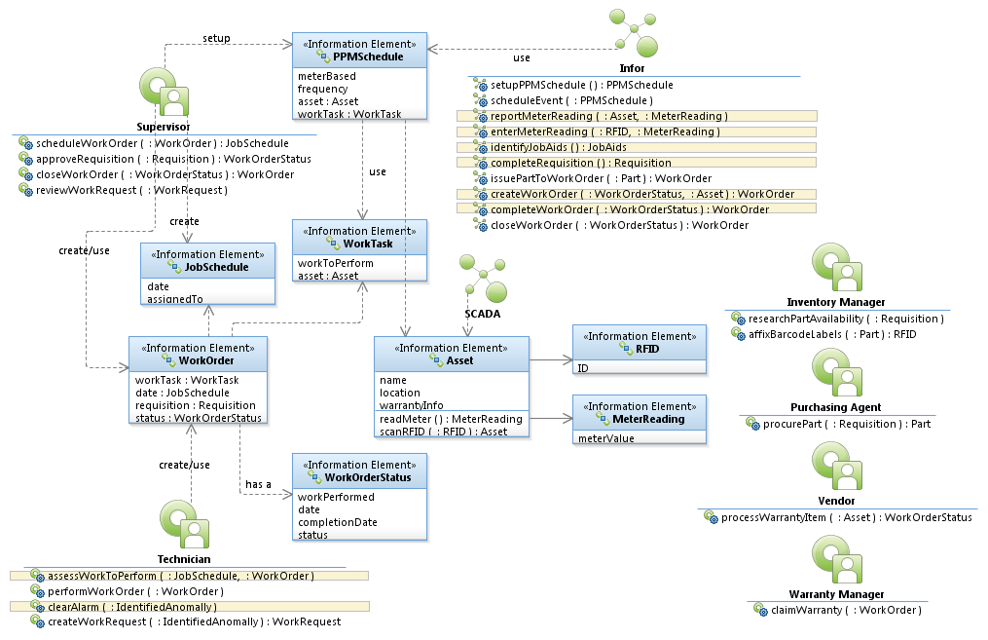
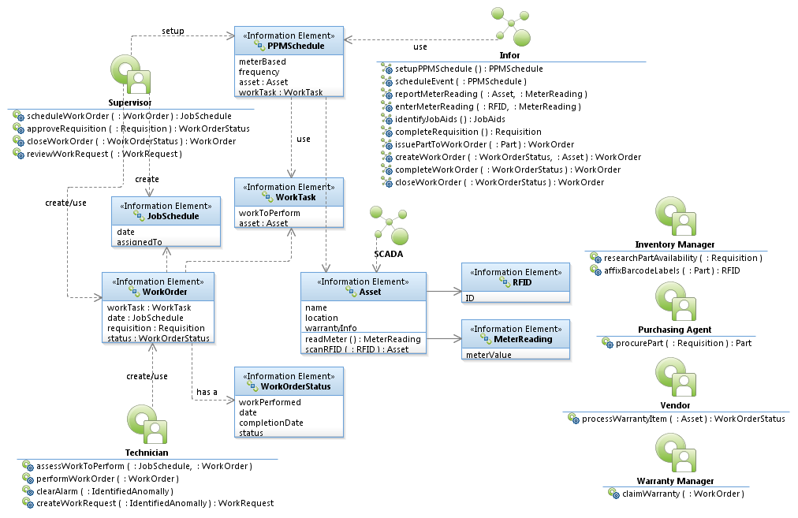
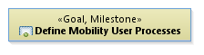


Work Order Logical Data Model

Slide 16
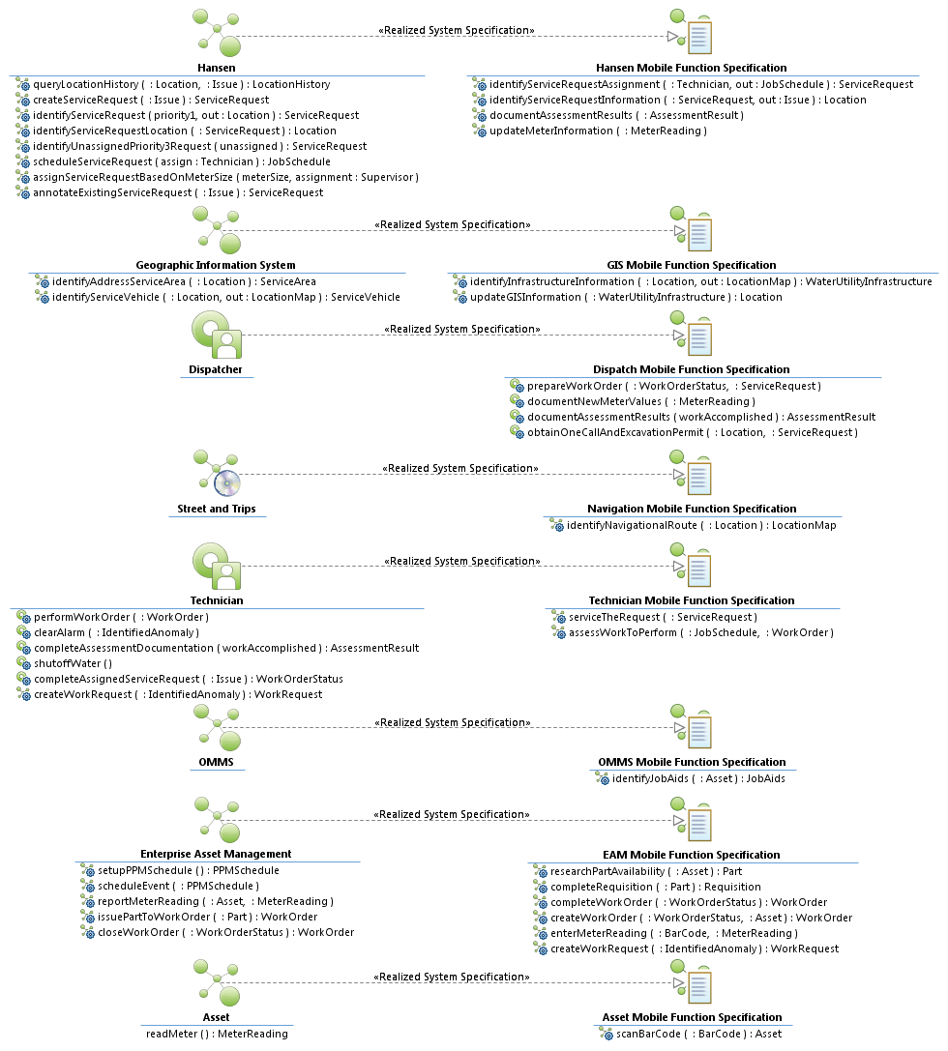
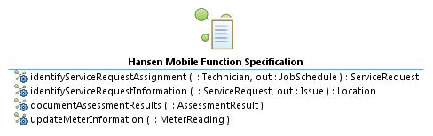
Mobile Function Specification

Slide 17
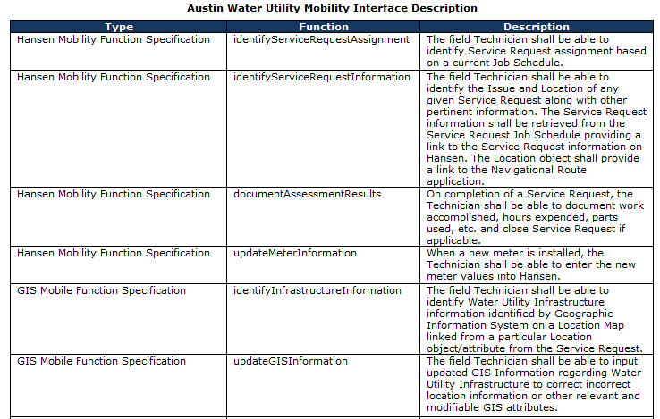
Interface Specification

Slide 18
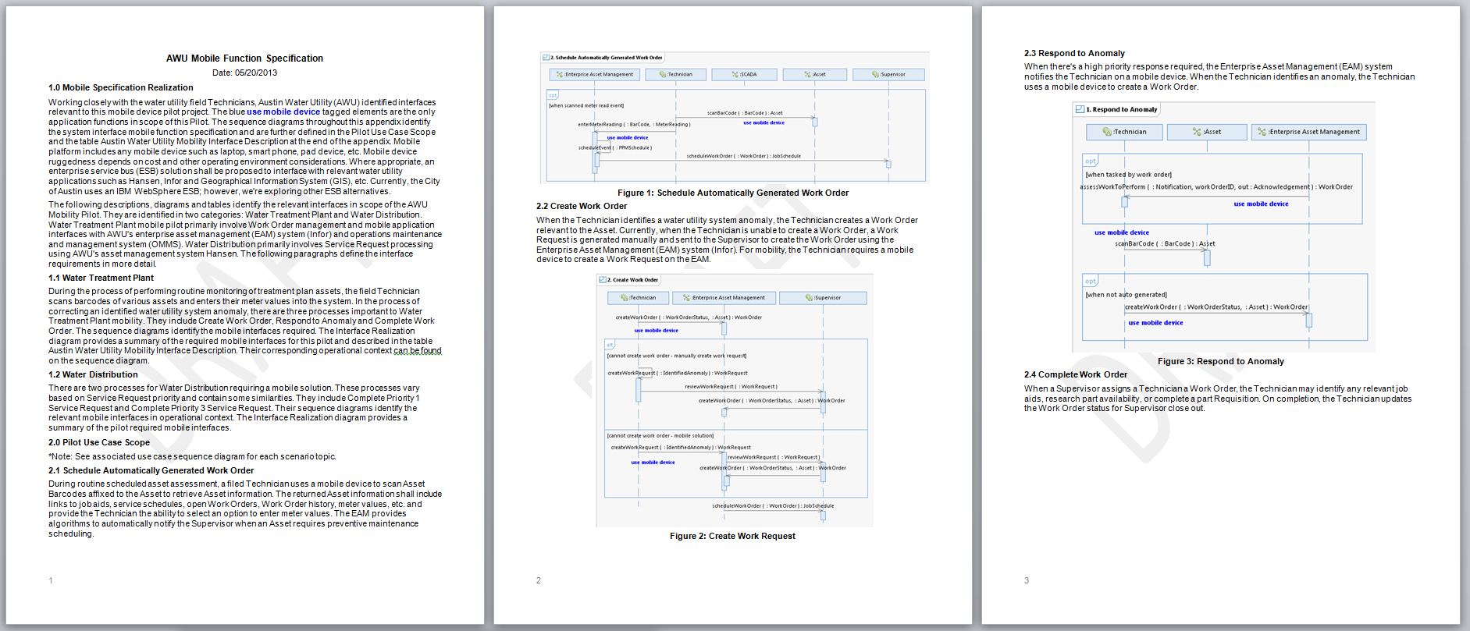
Develop Statement of Work
“This is the best written SOW that we have ever seen.” Esri
Identifies clearly understood scope - provides means to scope level of effort and ensured pilot includes relevant technologies
Reduces contractor risk resulting in reduced cost
Yields additional cost savings because contractor did not perform the business analysis
Needs identified by user community – increased buy in

Slide 19
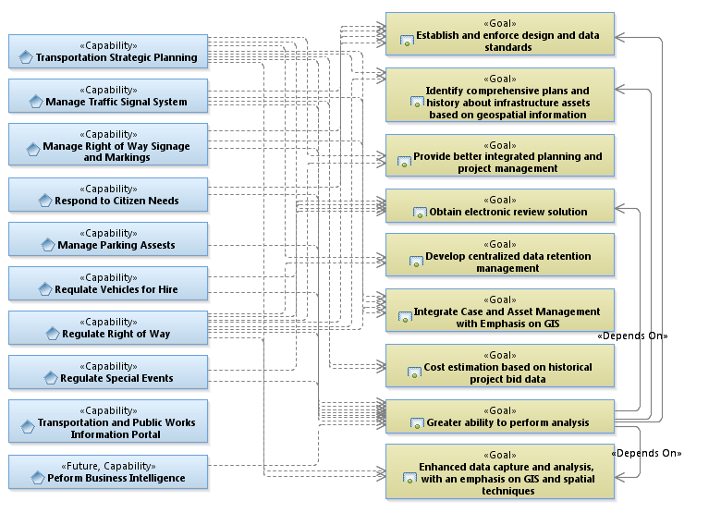
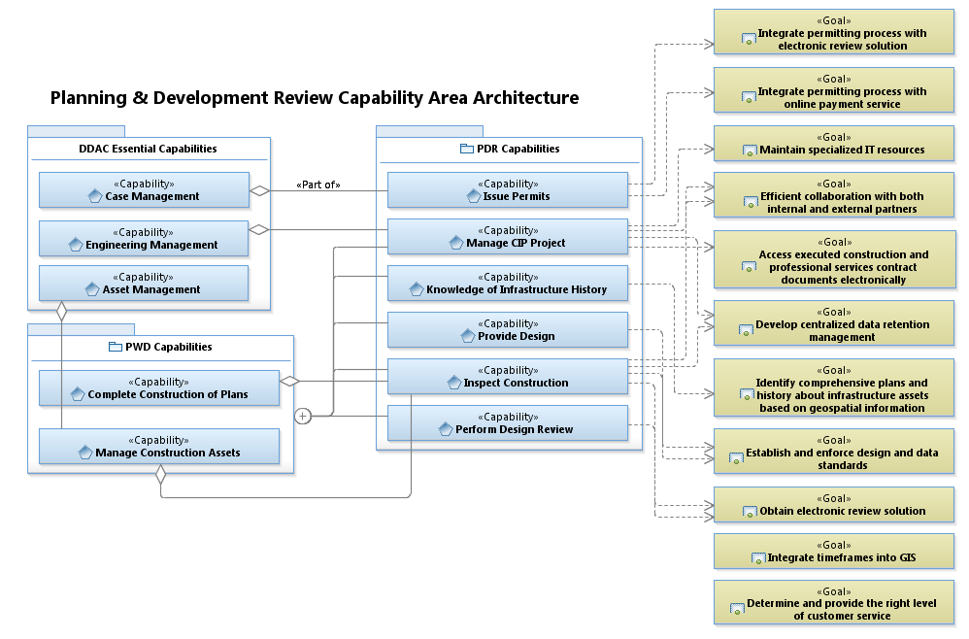
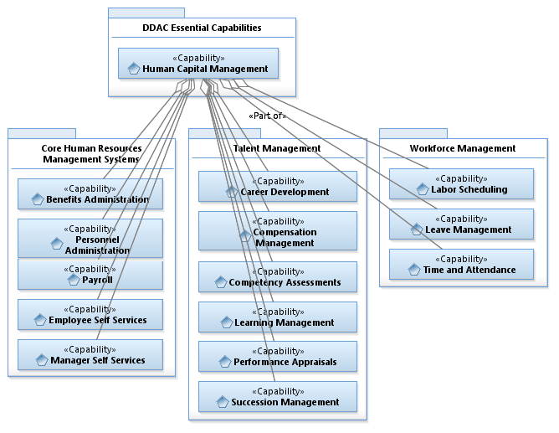
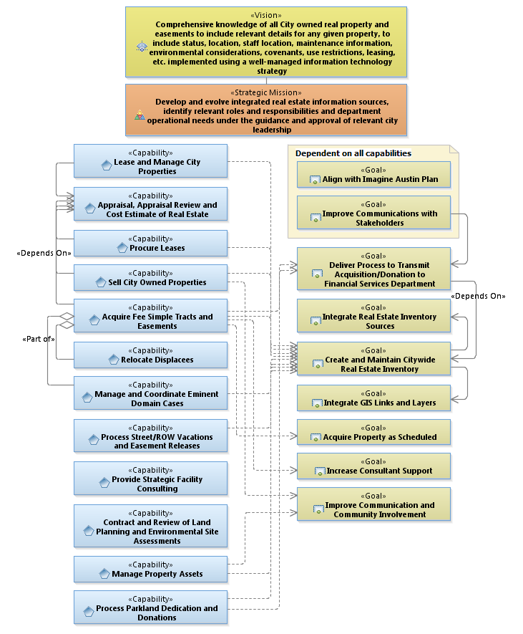
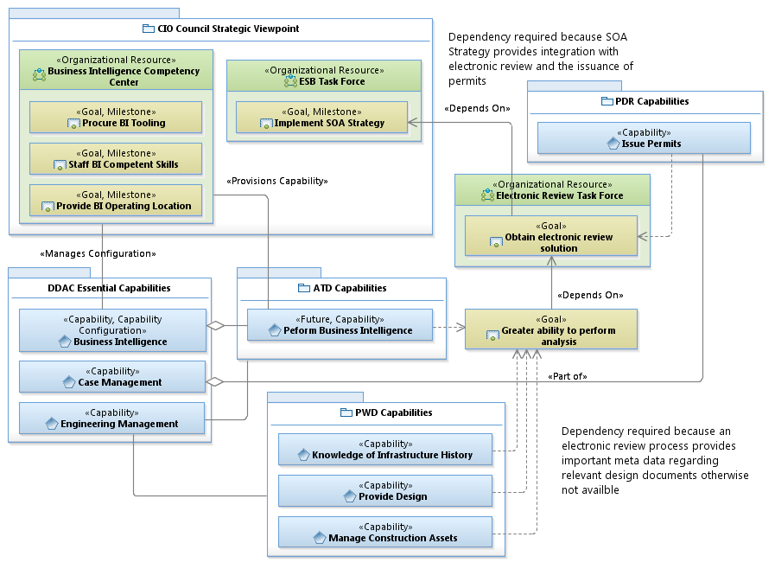
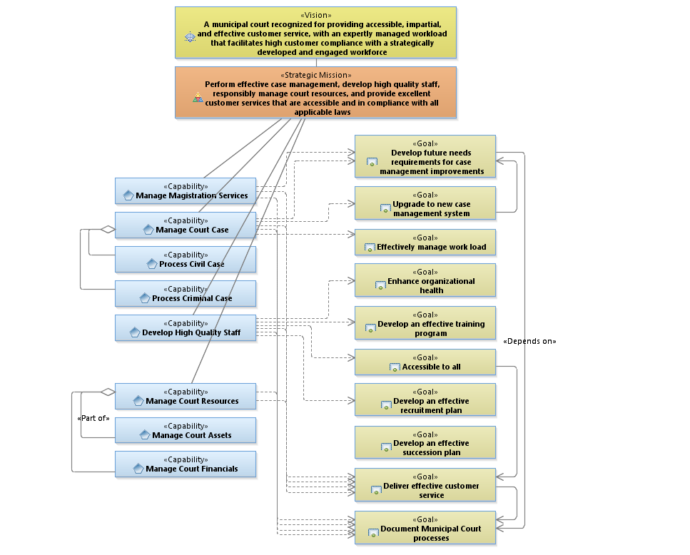
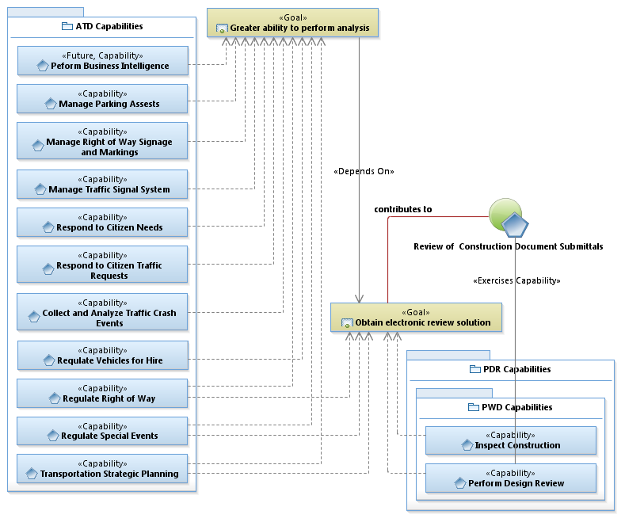
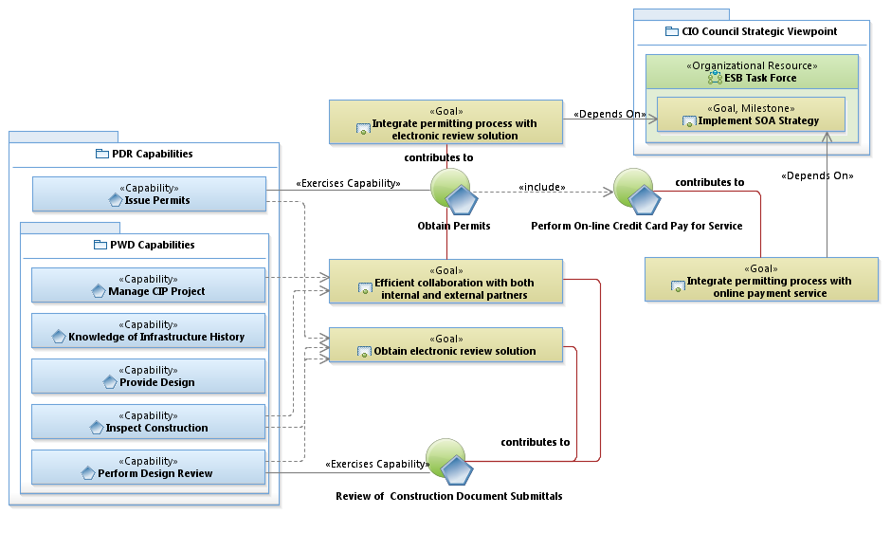
Business Strategic Viewpoints

Slide 20
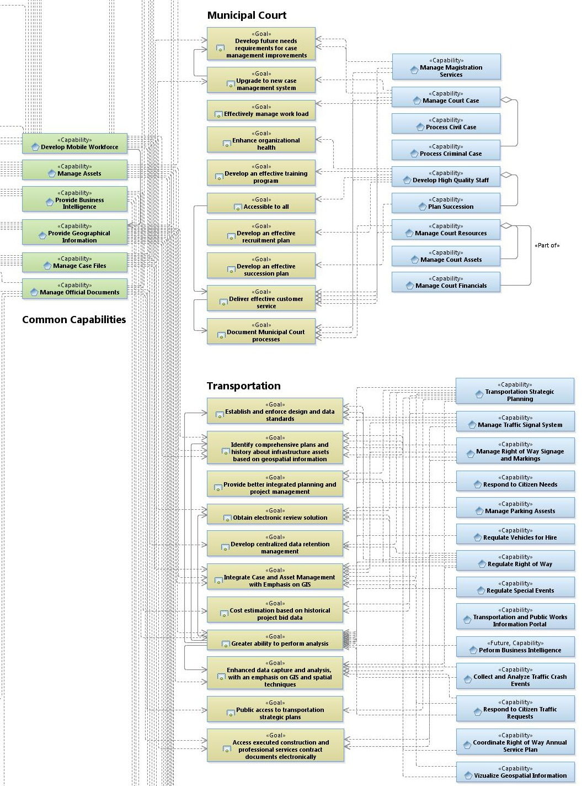
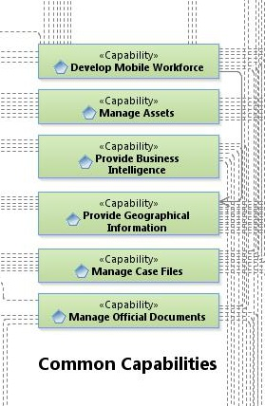
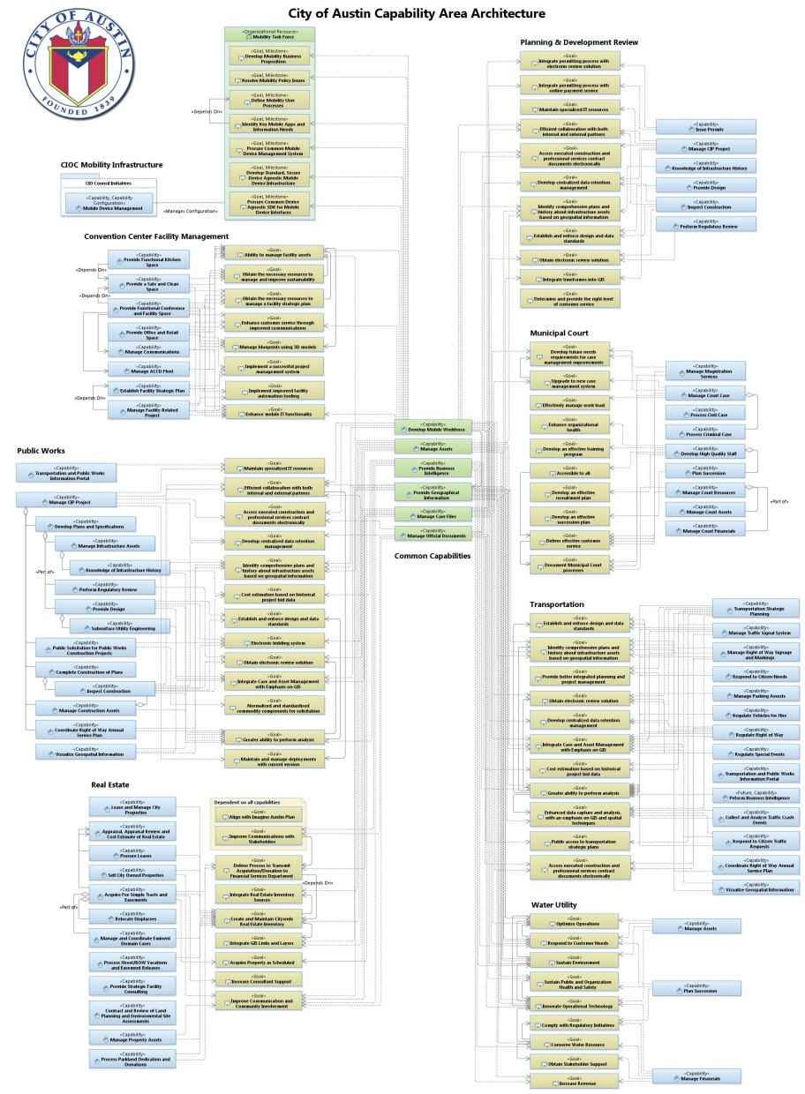
Business Strategic Viewpoints (Capabilities and Goals)
Business Capabilities
Business Goals
IT Services…

Slide 21
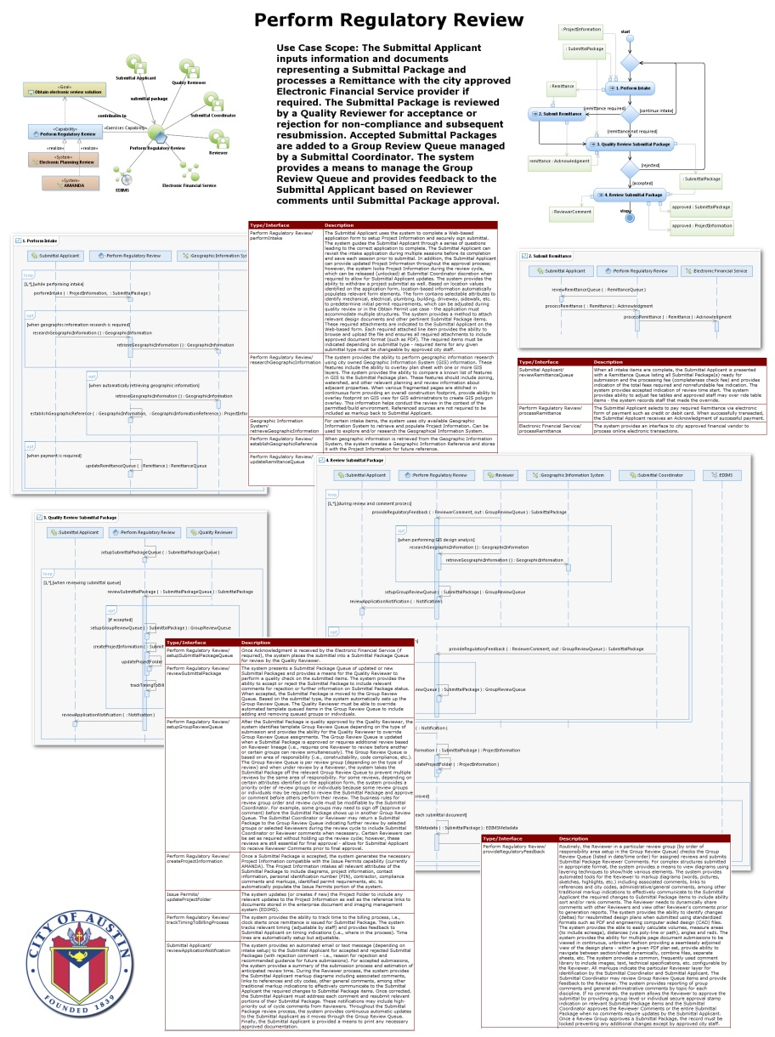
Goal Realization – EA Sequencing Plan
Realize the Goals
EA Sequencing Plan
Integrates the business need
Defines the customer experience
Capture the business rules
Provides ‘contract’ with the stakeholder

Slide 22
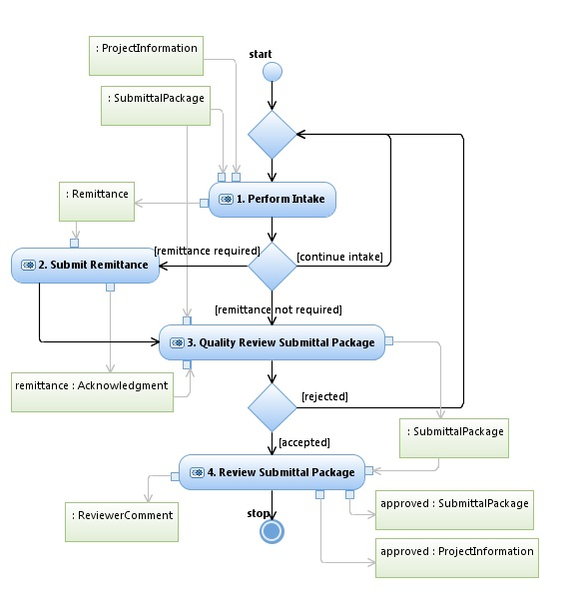
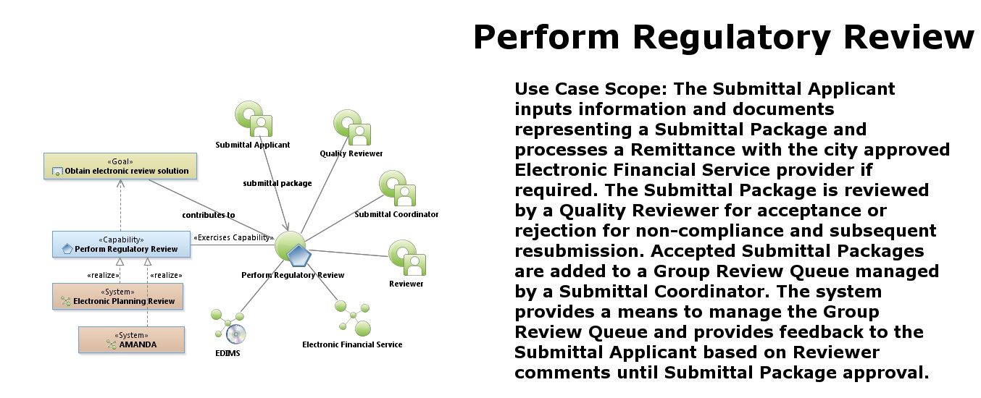
EA Sequencing Plan
Understand Process…
Common Capability - Common Goal Develop scope…

Slide 23
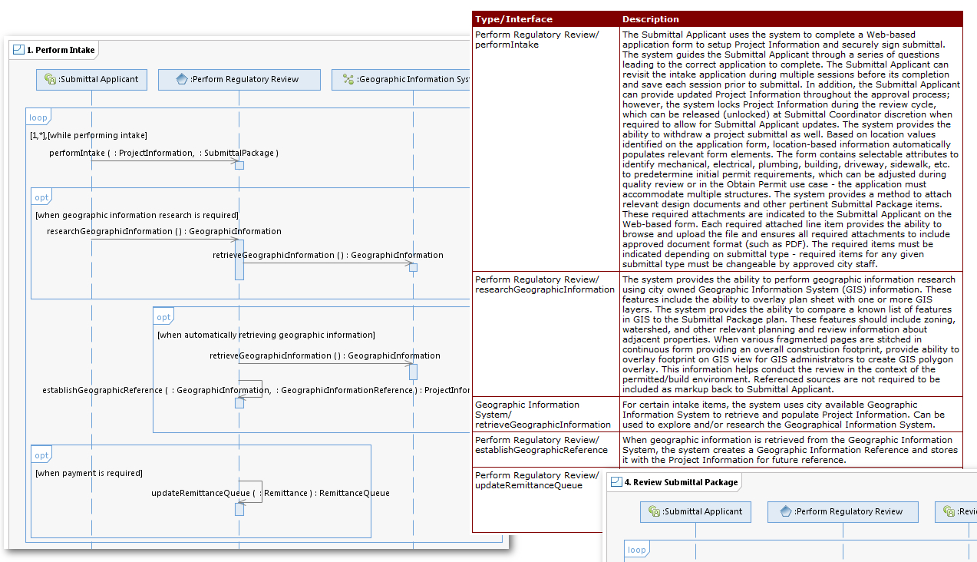
Define the Customer Experience
Integrate Business Need…
We only use the portion of the “as is” architecture necessary to innovate to the future state!

Slide 24
Develop Strategy
Examine IT service deliver to identify repurposing opportunities – train where needed
Establish and enforce enterprise solutions
Understand how business thinks to identify BI report needs
Integrate IT capabilities
Pursue opportunities from enterprise viewpoint
Insist on vetted architecture prior project approval and funding
Understand risk and include in decision-making
Obtain leadership support!
IT Services…

Slide 25

EA Derived IT Strategy
Vision | Recognized business partner One City IT | Imagine Austin E A20 - Improve government efficiency through technology (software and hardware) investments and by developing and retaining information technology staff
Principles | Demonstrate value as business partner Employ Enterprise Architecture in governance Integrate strategic plans Maximize use of common information system | Identify enterprise shared service opportunities Share common IT staff Identify reusable technology assets Provide business continuity
Common Capability | IT Imperatives | Future State
 | Build an end-to-end service model using Enterprise Architecture processes to align IT services to business needs Align IT services with required competencies – repurpose staff to increase business solutions – train to fill gaps Increase technical staff for high-value enterprise tools such as Maximo and Amanda Move toward mobile solutions Share services, not just data, with partnering agencies Integrate GIS with mobile and enterprise applications Mature service-oriented architecture using enterprise service bus (ESB) Exploit extract, translate and load (ETL) tooling for data warehousing and business intelligence – remove impediments to information | Empowered leadership and citizens Service-oriented provider Capable and competent staff Established systems of record Cross-department integration Policies, standards and practices Conduct business online Work anywhere online Open access to information

Slide 26
Next Steps
Analyze and redefine IT service delivery
Establish IT service managers responsible for Common IT Capabilities delivery
Clearly define IT service manager role and responsibilities aligned with Enterprise Architecture
Emphasize EA Sequencing Plan as business need
Increase EA Sequencing Plan delivery
Include EA in governance decision-making

Slide 27
Thank You!
Your Feedback is Important!
Access the Innovate agenda tool to complete your session surveys from your smartphone, laptop or conference kiosk.

